Slide 1
Shell Bootcamp 2024 3 Reflections for Week #3
<Shatakshi Shree>
Date : 13-Sept-2024

Slide 2

About Me
You either be as you seem or seem as you are. There is only one life, do your best and stand out. Spread happiness.

Slide 3

My learnings from this week!

Slide 4
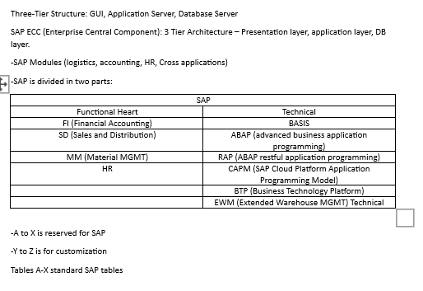
Learning 1 | My takeaways
A business process (BP) is a series of linked tasks aimed at delivering a service or product to a client, achieving organizational goals. Key functional areas include finance and accounting (FI), supply chain management (SCM), marketing and sales (MS), and human resources (HR). Each area has specific operations, such as marketing, sales, customer support (MS), purchasing, logistics, manufacturing (SCM), financial accounting, budgeting (FI), and HR activities like recruitment and payroll. ERP systems optimize and track these functions, integrating them into a single system, enhancing efficiency and reducing costs. SAP, a leading ERP provider, offers modules like FI, SD, MM, and HR, with a three-tier architecture (GUI, application server, database server). SAP projects include implementation, support, rollout, and upgrade, following a structured methodology. SAP ABAP, the programming language, supports various program types and enhancements, crucial for customizing and extending SAP functionalities.

Slide 5
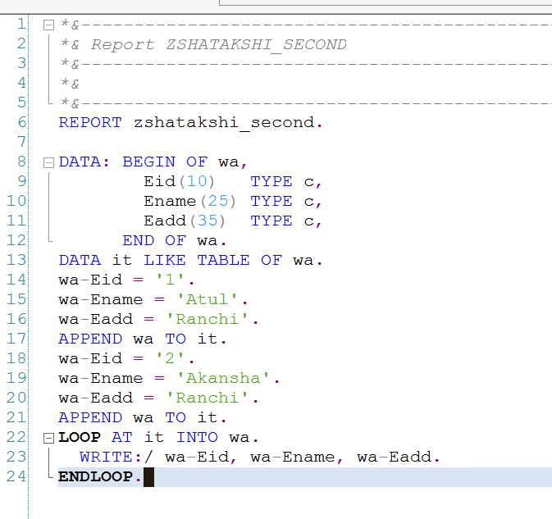
Learning 2 | My takeaways
HANA stands for High-Performance Analytic Appliance. Operators are mathematical and comparative, while operands are variables for operations. Keywords in ABAP identify statement types, including calling, controlling, declaration, definition, DB, event, and operational keywords. Declaration keywords like Data and Parameters declare variables. Data types are numeric (integer, float, packed decimal) and character (char, numeric char, date, time). Statements end with a period, and integers default to zero. Packed decimal syntax is `Data <variable name>(<length>) type P decimals <no>`. Parameters can have default values and be obligatory. Open SQL, database-independent, supports SAP but not DDL. The Data Dictionary (DDIC) creates or alters tables using domains and data elements. Technical requirements for tables include naming conventions, field lists, delivery class, and technical settings. Domains define data types and lengths, while data elements combine domains with descriptions. Foreign keys validate data between tables. Table types include transparent, cluster, and pool.

Slide 6
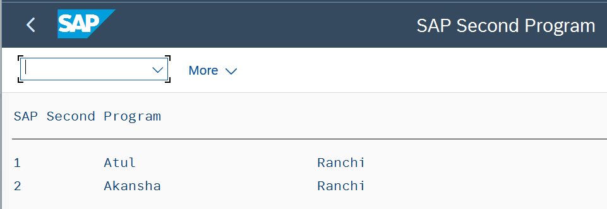
Learning 3 | My takeaways
Indexes improve the performance of select queries. Primary indexes are mandatory for custom tables, with up to 16 allowed per table, while secondary indexes, up to 9 per table, can be created for both standard and custom tables. The command `/O` opens a new session without closing the current one, whereas `/N` opens a new session and closes the current one. Internal tables are temporary collections of records used to fetch data from other tables into a program. They are declared using the syntax `Data <internal table> like table of <work area>`. Fields within internal tables can be declared using various syntaxes, such as `Data <field name>(<length>) type <data type>`, `Data <field name> type <data elements>`, or `Data <field name> type <database table>-<field name>`. Internal tables act as buffers, storing data temporarily for processing within the program.

Slide 7

Relevance of learnings for my organization

Slide 8
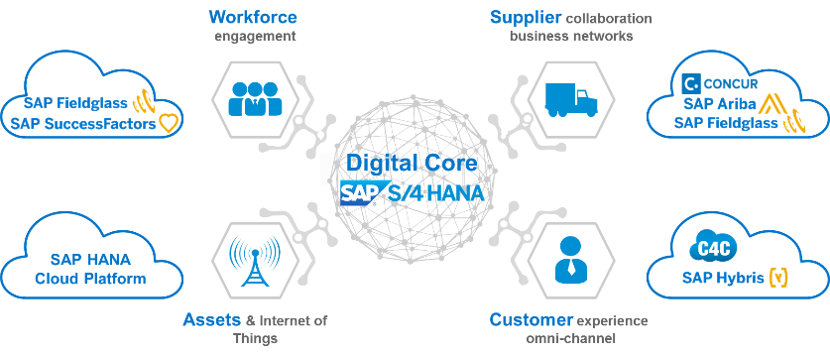
Learning 1 | Relevance for Shell
SAP S/4HANA is crucial for Shell's digital transformation, simplifying operations by consolidating around 30 ERP systems into a unified platform. This transition enhances data consistency, operational efficiency, and agility, enabling faster decision-making and cost reduction. Shell's strategy includes deploying multiple SAP S/4HANA instances tailored to various business needs, aiming for a fully cloud-based solution. This transformation aligns enterprise systems, streamlines processes, and simplifies data management, driving significant value for Shell.

Slide 9
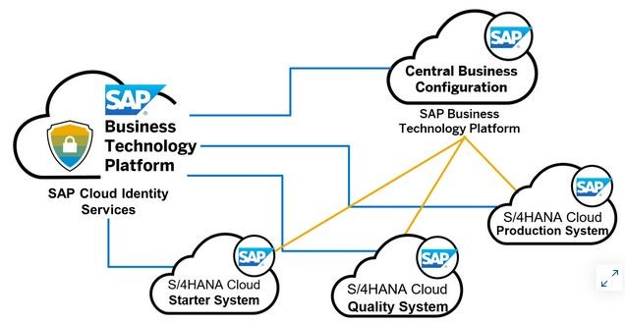
Learning 2 | Relevance for Shell
HANA is crucial for Shell's digital transformation, enabling the consolidation of around 30 ERP systems into a unified SAP S/4HANA platform. This transition enhances data consistency, operational efficiency, and agility, facilitating faster decision-making and cost reduction. Shell's strategy includes deploying multiple SAP S/4HANA instances tailored to various business needs, aiming for a fully cloud-based solution. This transformation aligns enterprise systems, streamlines processes, and simplifies data management, driving significant value for.

Slide 10
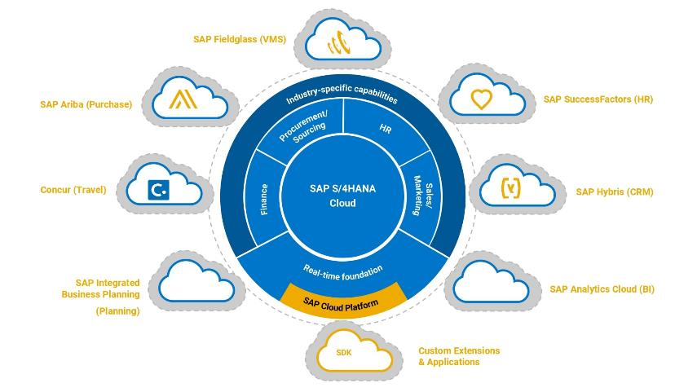
Learning 3 | Relevance for Shell
Indexes and internal tables are crucial for Shell's SAP S/4HANA implementation. Indexes enhance query performance, ensuring faster data retrieval, which is vital for Shell's large-scale operations. Internal tables allow temporary data storage and manipulation within programs, facilitating efficient data processing and integration across various modules. These tools help streamline operations, improve data management, and support Shell's goal of achieving a unified, agile, and efficient ERP.

Slide 11

Challenges in implementing learning

Slide 12
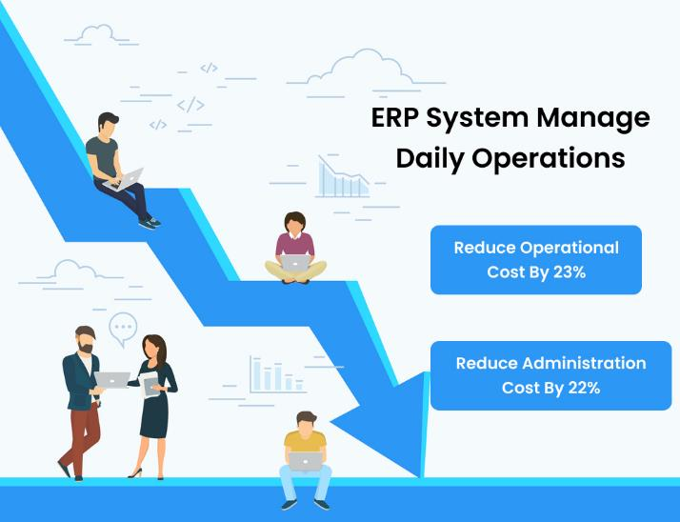
Challenge faced while implementing Learning 1
Implementing SAP S/4HANA can be challenging due to complex data migration, requiring extensive cleansing and validation. Customizing existing functionalities to fit the new system adds to the complexity. User resistance is common, necessitating thorough training and change management. Integration with existing systems and third-party applications can pose difficulties. Effective project management is crucial to avoid delays and cost overruns. Addressing these challenges demands meticulous planning, clear communication, and robust training programs to ensure a smooth transition.

Slide 13
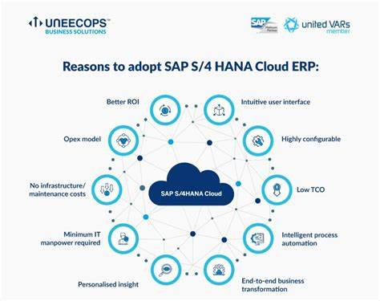
Challenge faced while implementing Learning 2
Implementing SAP S/4HANA at Shell can present several challenges. Data migration from legacy systems is complex and requires thorough cleansing and validation to ensure consistency. Customizing existing functionalities to fit the new system can be time-consuming. User resistance is common, necessitating extensive training and change management. Ensuring seamless integration with existing systems and third-party applications can be difficult. Effective project management is crucial to avoid delays and cost overruns. Addressing these challenges requires meticulous planning, clear communication, and robust training

Slide 14
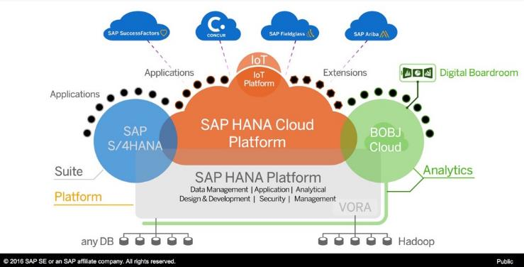
Challenge faced while implementing Learning 3
Implementing indexes and internal tables in SAP S/4HANA at Shell can be challenging due to complex data migration, requiring thorough cleansing and validation. Customizing existing functionalities to fit the new system can be time-consuming. Ensuring seamless integration with existing systems and third-party applications can pose difficulties. Effective project management is crucial to avoid delays and cost overruns. Addressing these challenges demands meticulous planning, clear communication, and robust training

Slide 15

Action Plan

Slide 16
My Action Plan for this Week
Actions
Timeline
Status
Practicing SAP ABAP codes, revising the workbench topics
Saturday - Practice codes
Sunday – See S/4 HANA
Completed

Slide 17

Learning is also Fun!

Slide 18

Learning is also Fun!
We learned a lot of topics specially the technical part of all topics which we really enjoyed. Sir even took us for lunch. Ali sir is just amazing. His teaching skills are commendable, feels like everything gets imbibed inside the brain. We don’t have to put much effort in revising because we know how things work. The hands-on experience before working on the tech stacks made us comfortable with the environment. Ali sir is best!

Slide 19

Summary
Learned ERP, SAP, ABAP.
S/4 HANA, BTP and selection screens
Migrating from ABAP to HANA.

Slide 20
Thank You

